Slide 1
3K pos

Slide 2
Settings

Slide 3
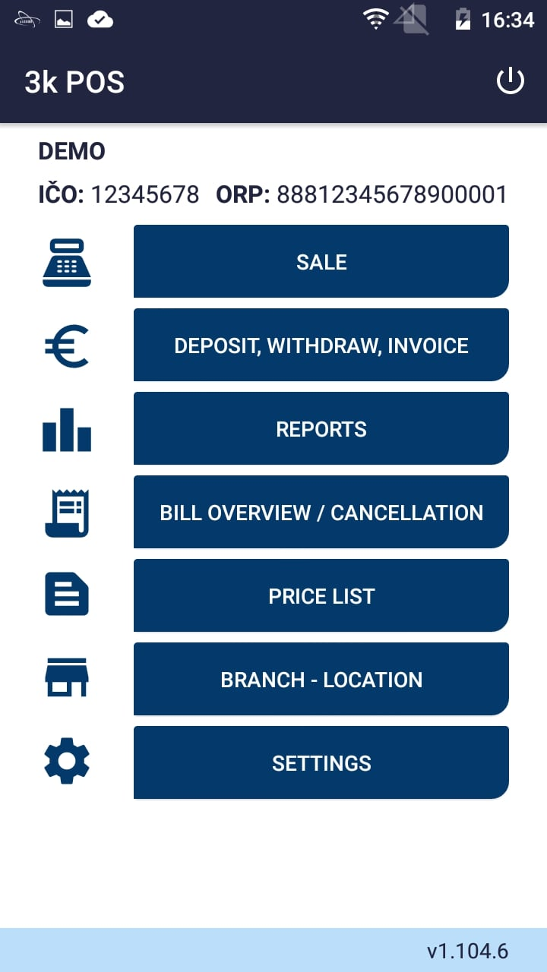
Click „Settings“

Slide 4
Click „POS“

Slide 5
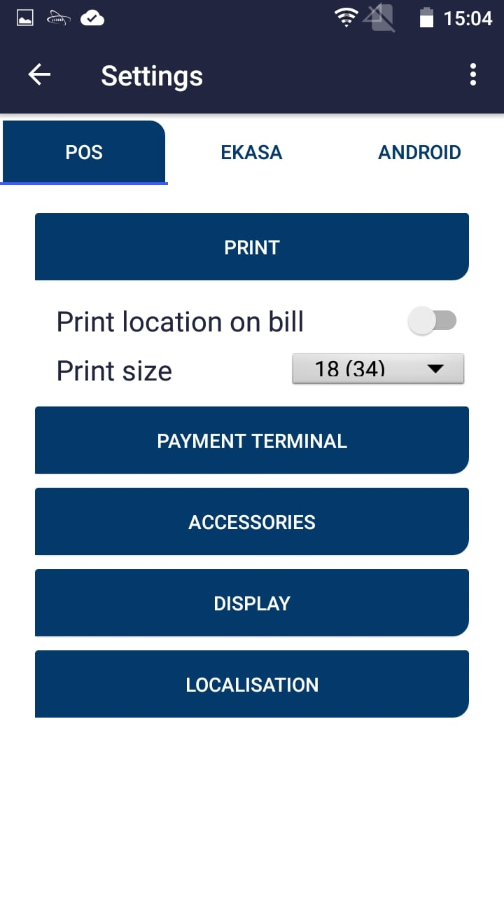
Click „Print“

Slide 6
Allow location printing on bill
Print size setting

Slide 7
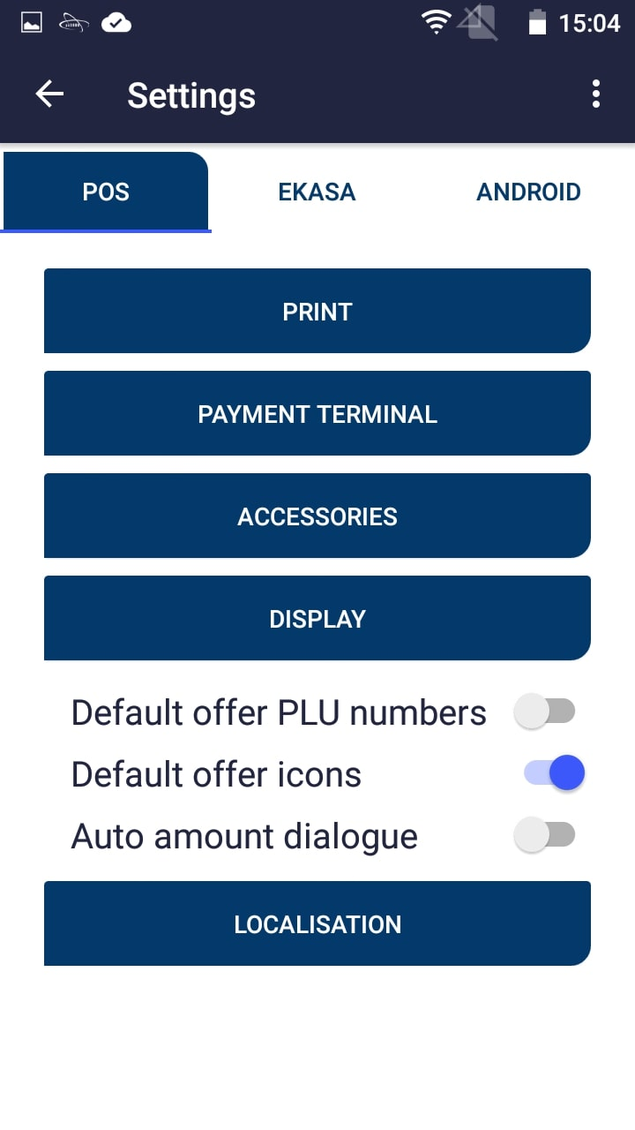
Click „Payment terminal“

Slide 8
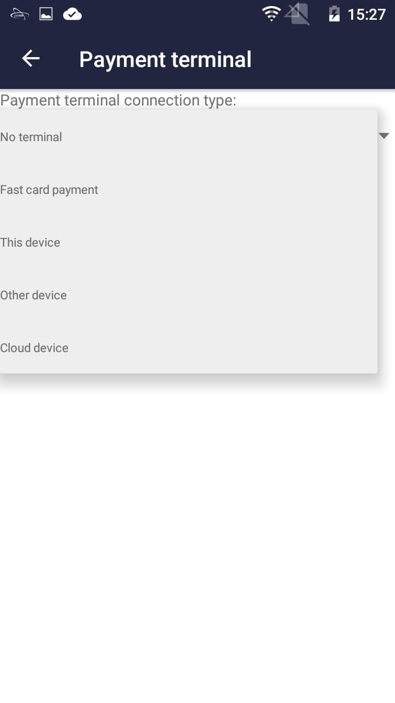
Choosing „Fast card payment“ will register the payment as a card payment. The actual transaction has to be made on a different terminal
Choosing „This device“ will use internal payment app
Choosing „Other device“ will set external device as your payment terminal
Choosing „Cloud device“ will set a cloud device as your external payment terminal

Slide 9
Click „Display“

Slide 10
Choose display option

Slide 11
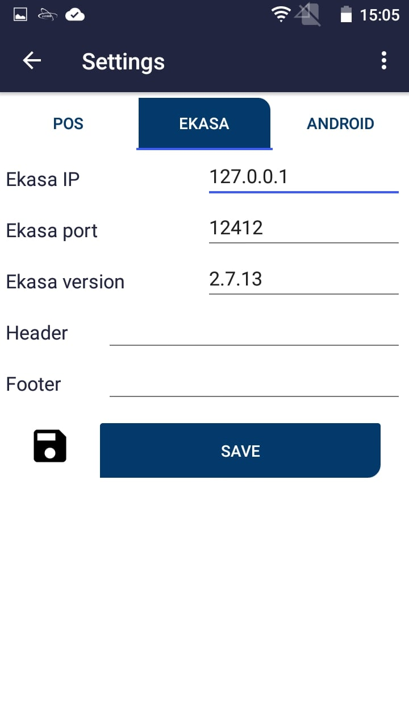
Click „EKASA“

Slide 12
Here you can set Ekasa IP and Ekasa port
Here you can set header and footer for the receipt

Slide 13
Click „Save“

Slide 14
Pricelist

Slide 15
Click „Price list“

Slide 16
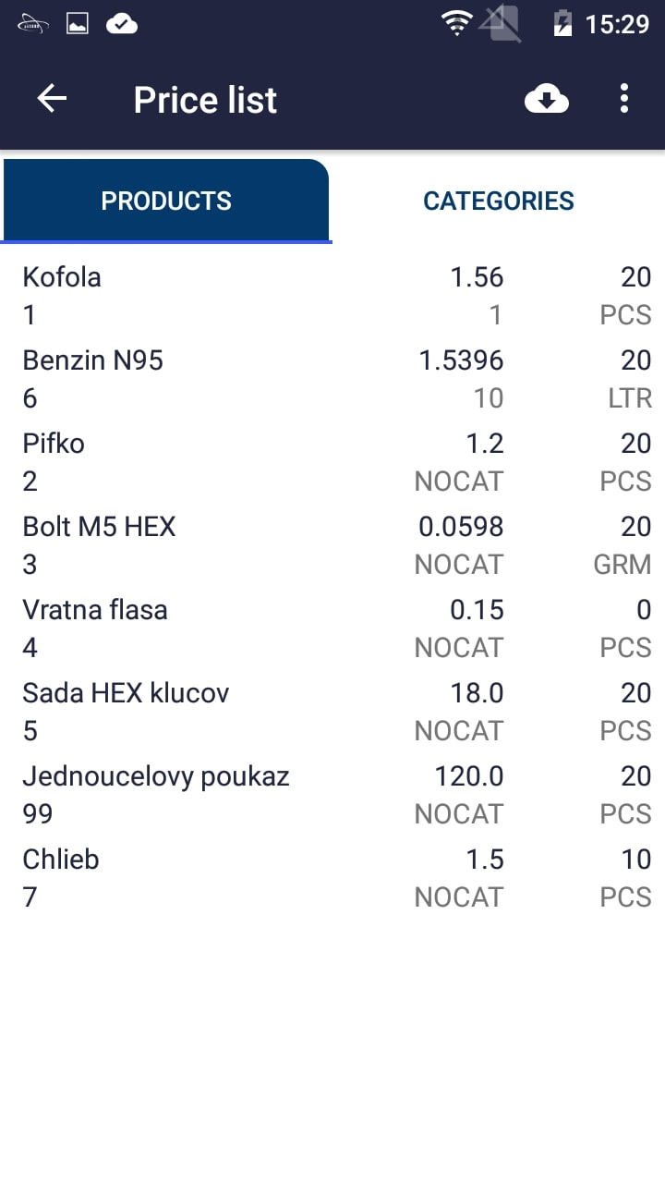
Clicking will open advanced settings
Clicking will download pricelists from server

Slide 17
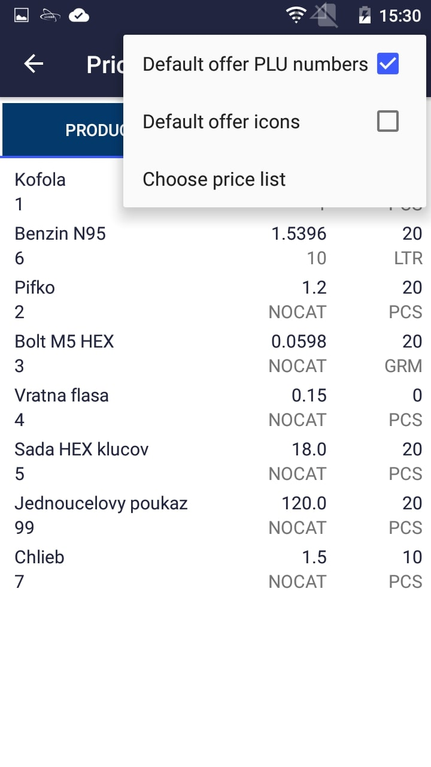
Clicking this will allow you to select a specific price list

Slide 18
Sale

Slide 19
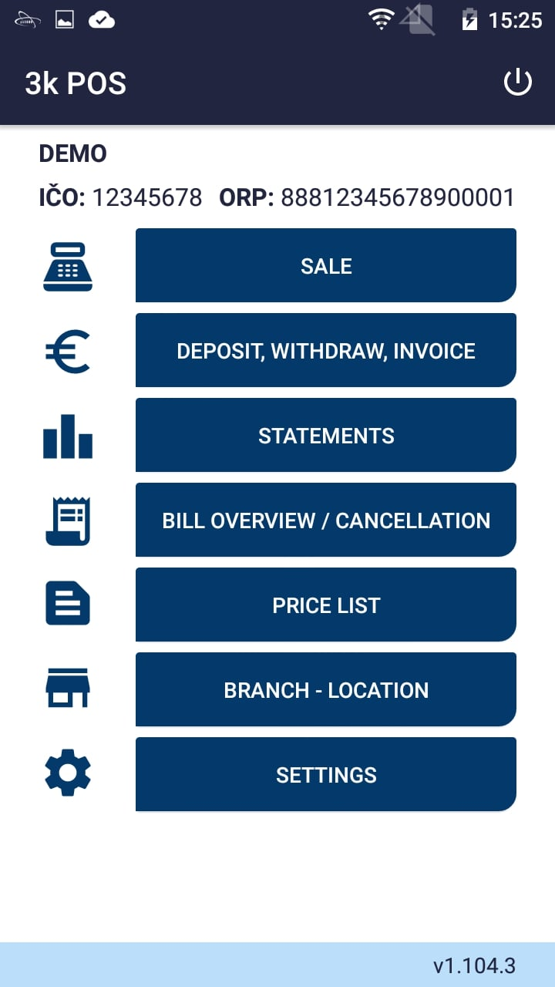
Click „Sale“

Slide 20
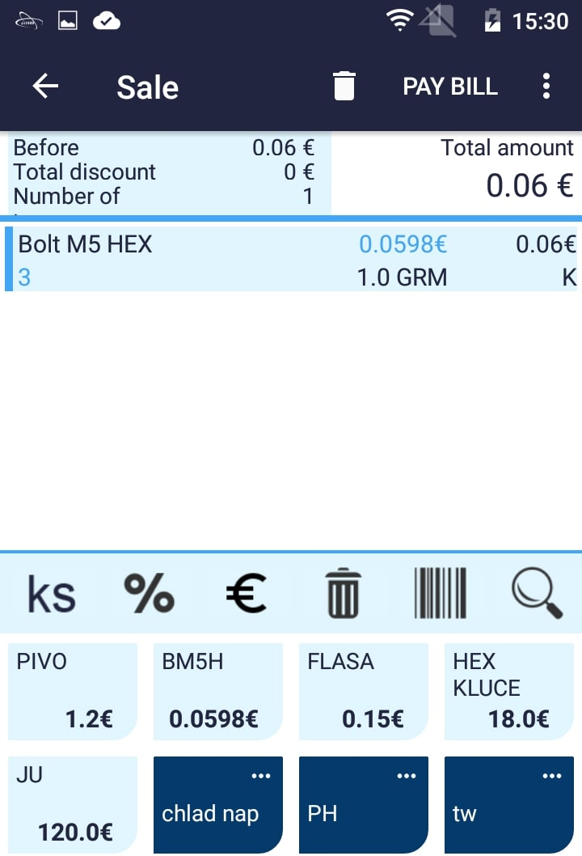
Clicking an item will allow you to change the price, apply a discount and etc.
Setting the amount, discount, price of item, deleting an item, scanning a bar code and searching for item
Pricelist items
Pricelist categories

Slide 21
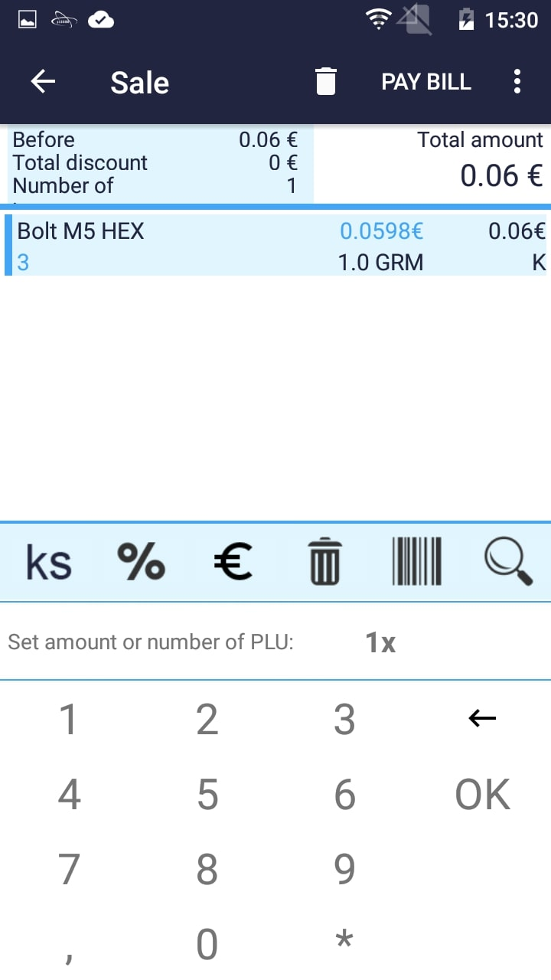
Clicking will open advanced settings
Clicking will delete the whole document
Clicking will forward you to payment
In case you have selected display PLU numbers, you will have to input amount * PLU

Slide 22
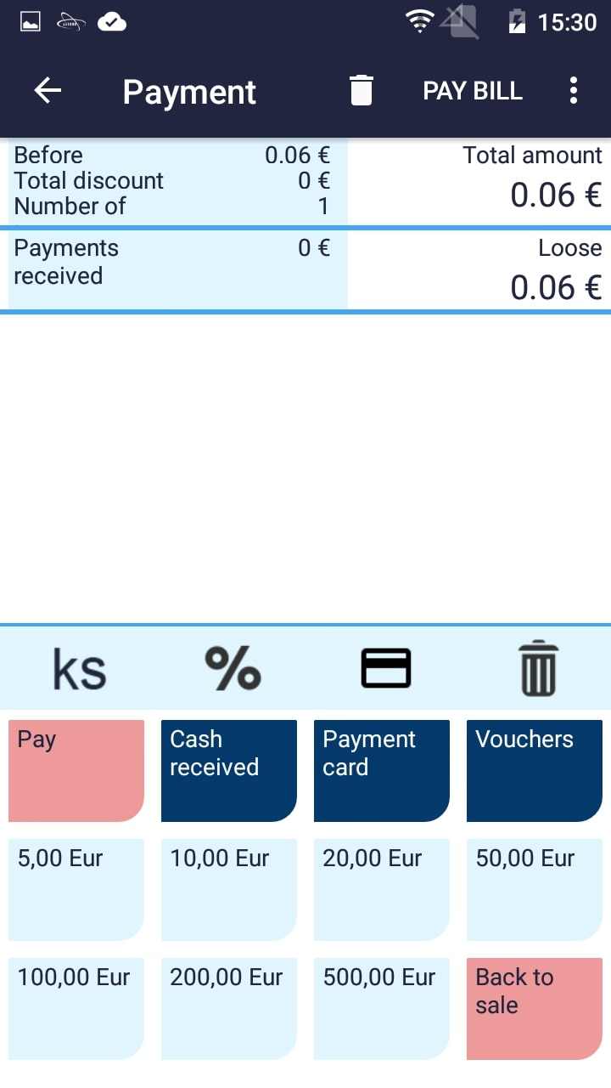
Clicking will apply a discount for the whole bill
Clicking will add a loyalty card
Clicking will set the amount of selected item
Clicking will delete all payments
Clicking will pay the bill
Clicking will add the amount of selected received cash

Slide 23
By clicking „received cash“ you can enter the exact amount of received cash
Clicking „Payment card“ will select payment by card
Clicking „Vouchers“ will select voucher payment

Slide 24
In case you have selected „Fast card payment“ in the settings, it is required to carry out the transaction on the external terminal first

Slide 25
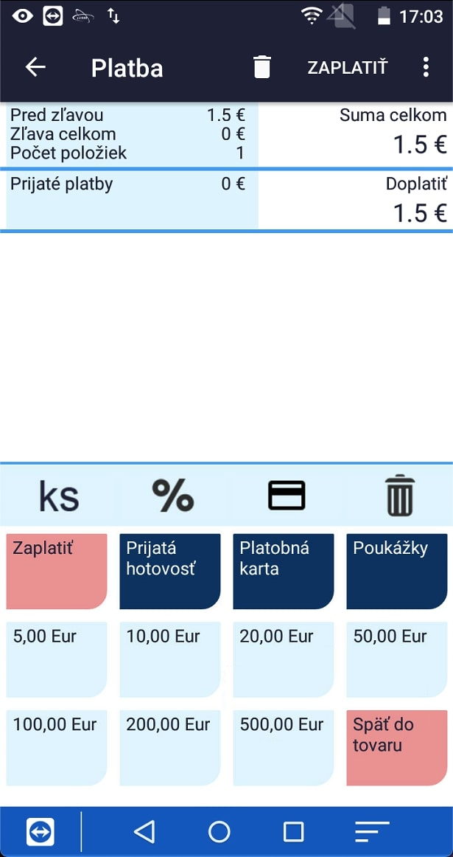
After a successful transaction on the external device click „Pay by card“ and afterwards click „Pay bill“

Slide 26
BILL OVERVIEW / CANCELLATION

Slide 27
Click „Bill overview / cancellation“

Slide 28
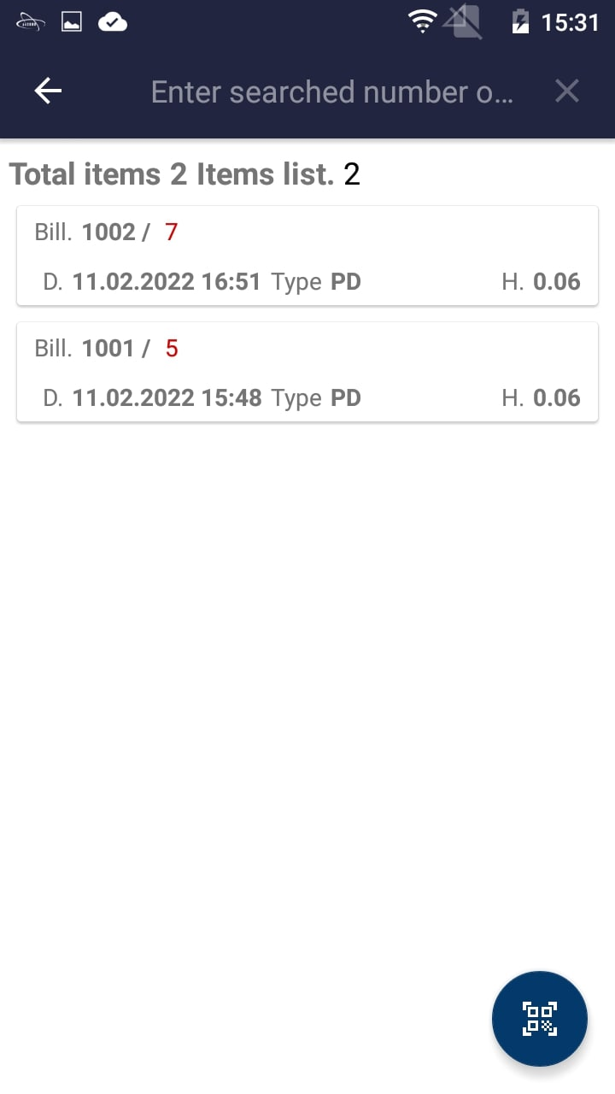
Cancel a bill by clicking on it
Clicking will enable you to scan a QR code and cancel the bill

Slide 29
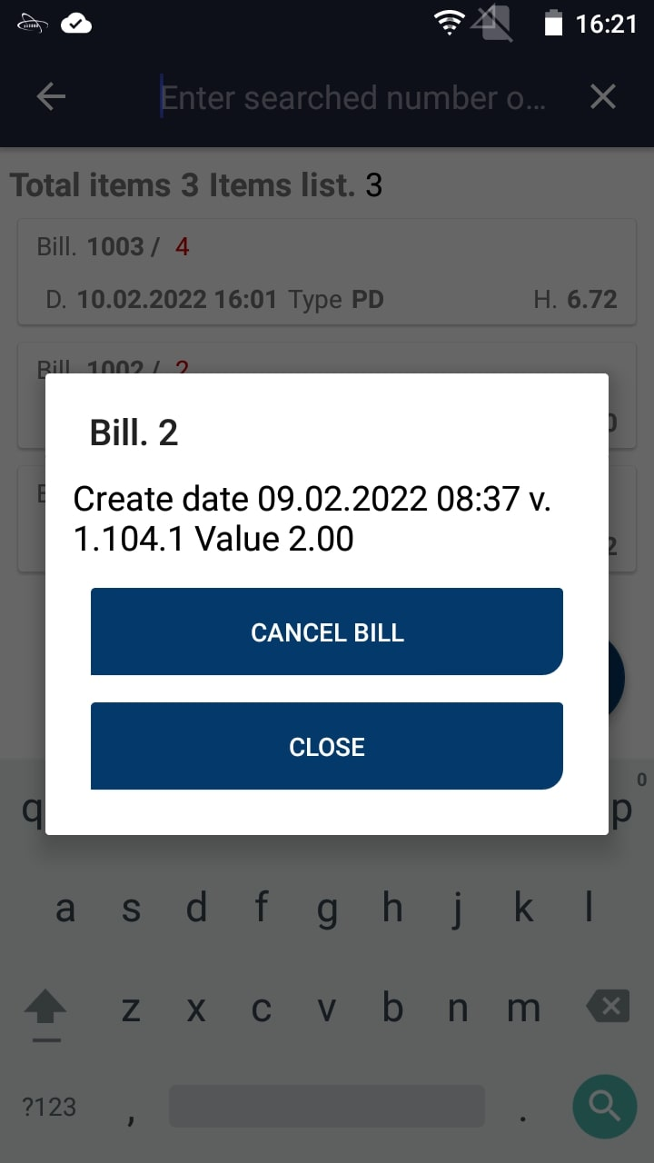
Clicking will cancel the bill

Slide 30
DEPOSIT, WITHDRAW, INVOICE

Slide 31
Click „Deposit, Withdraw, Invoice“

Slide 32
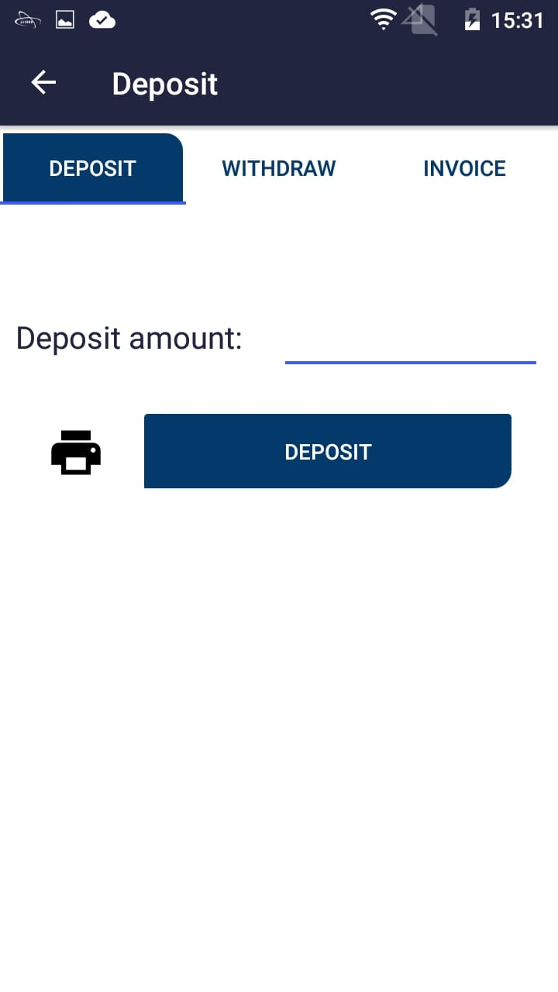
Click to deposit

Slide 33
Enter the amount

Slide 34
Click „Deposit“

Slide 35
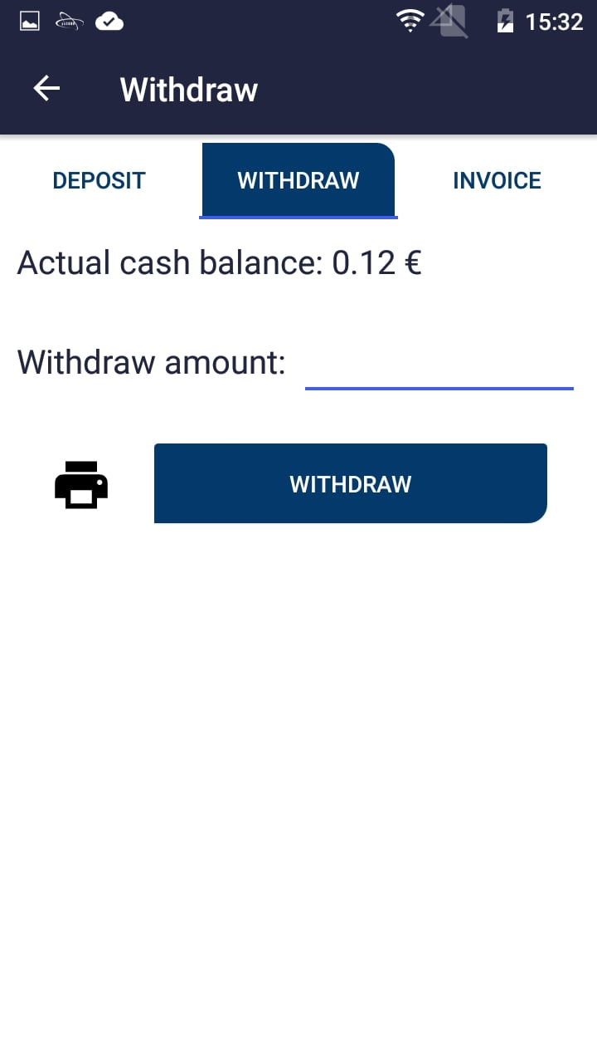
Click to withdraw

Slide 36
Enter the amount

Slide 37
Click „Withdraw“

Slide 38
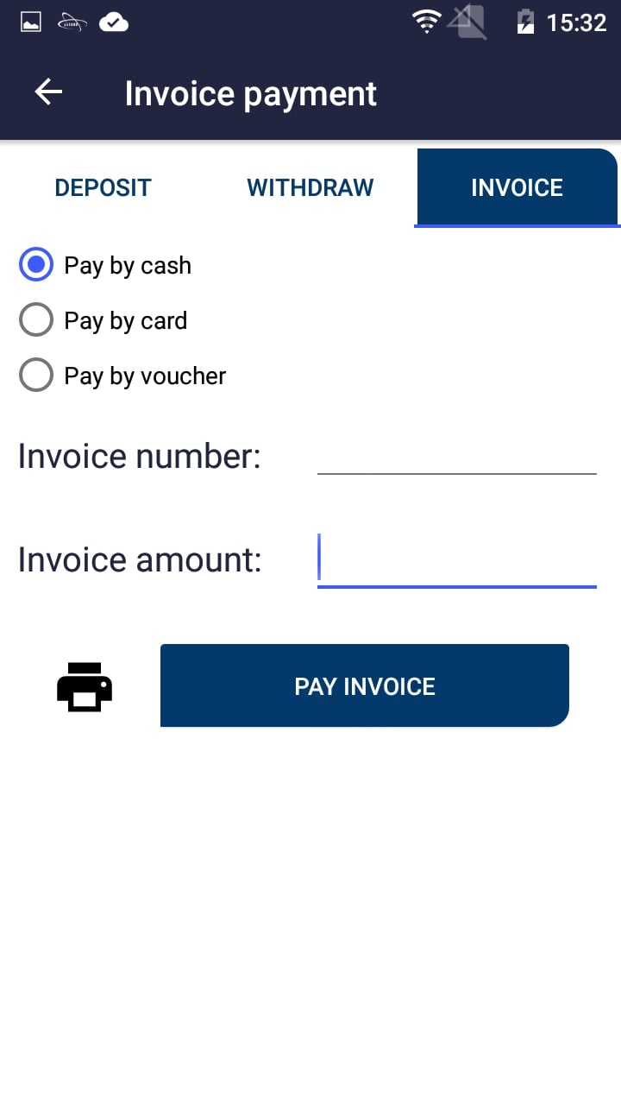
Click to pay invoice

Slide 39
Fill out the invoice details

Slide 40
Click „Pay invoice“

Slide 41
Reports

Slide 42
Click „Reports“

Slide 43
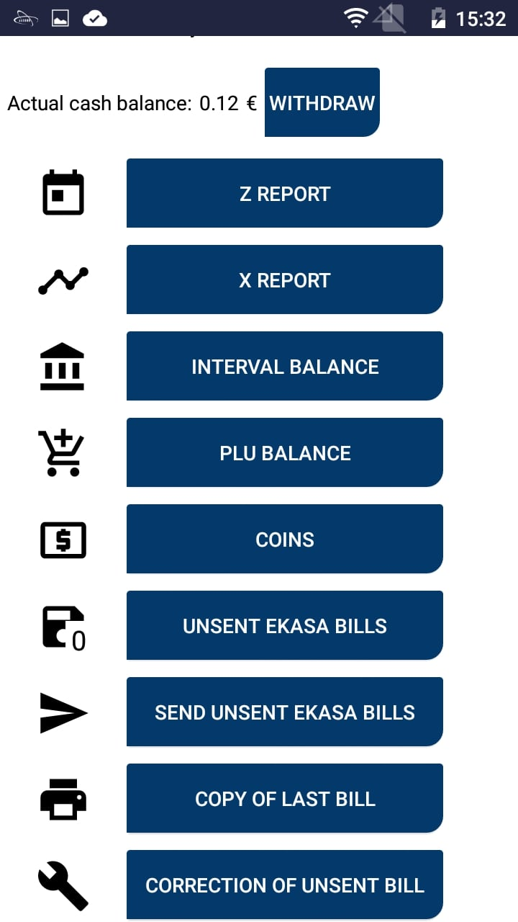
Basic Reports
Number of unsent ekasa bills
Clicking will send unsent ekasa bills
Clicking will print a copy of last document
Clicking will repair last unsent document

